Slide 1
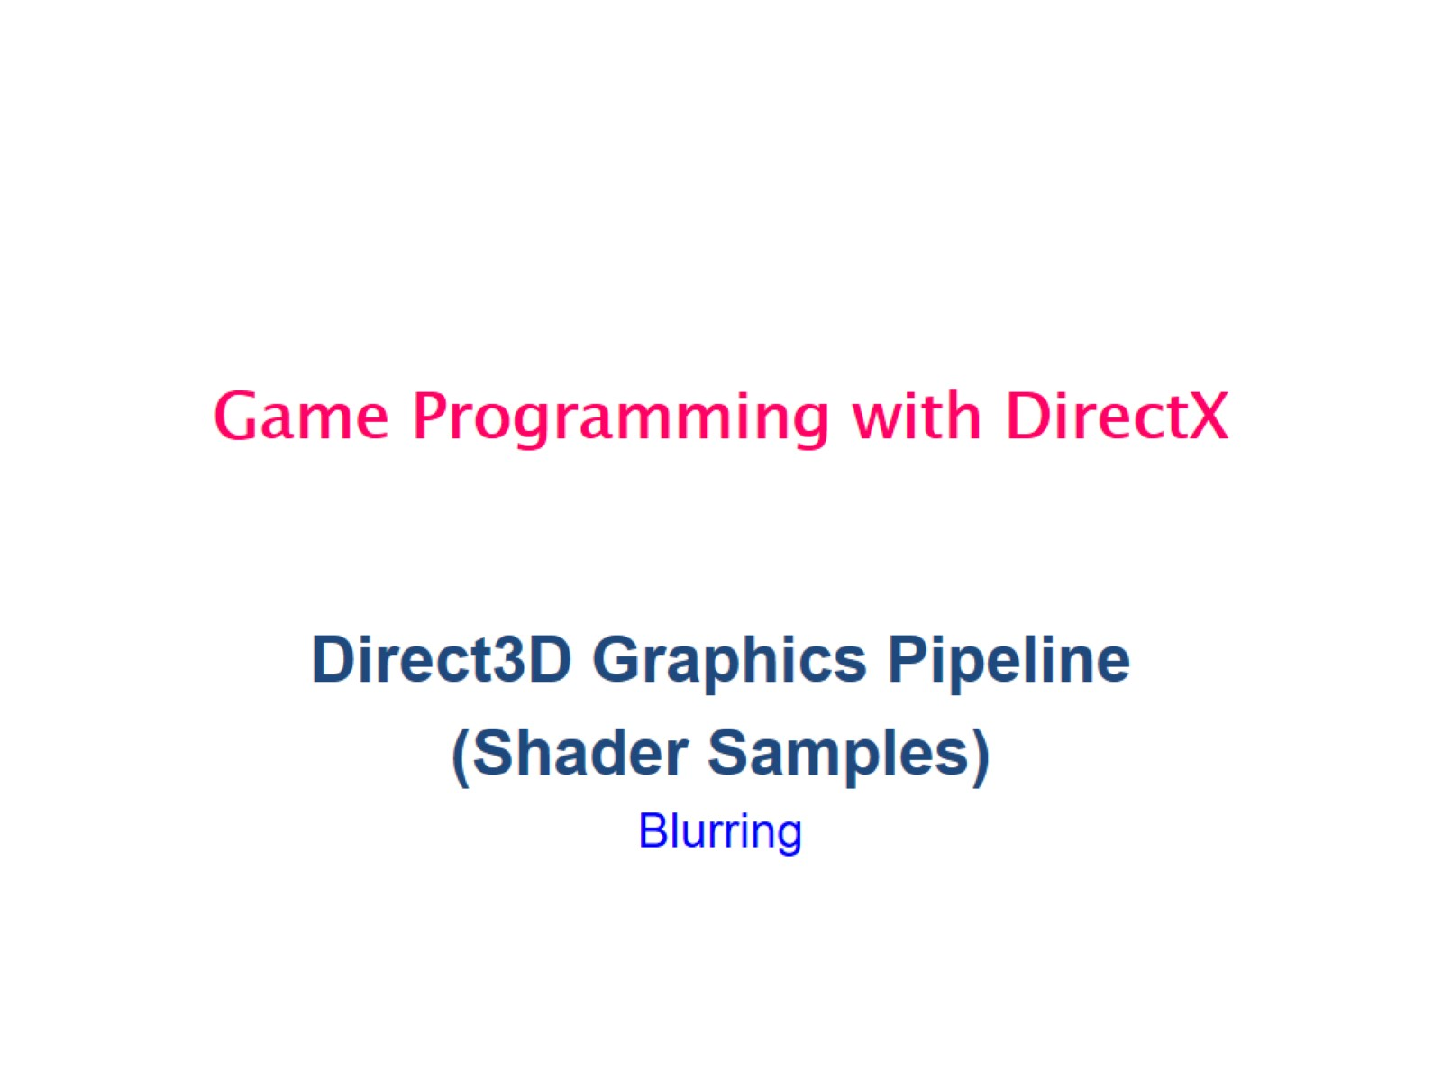
Game Programming with DirectX

Slide 2
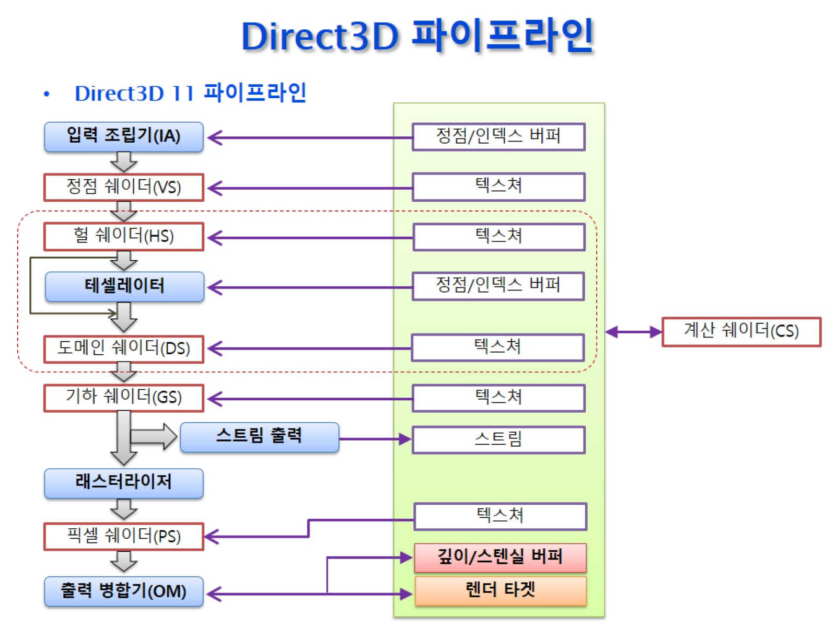
Direct3D 파이프라인

Slide 3
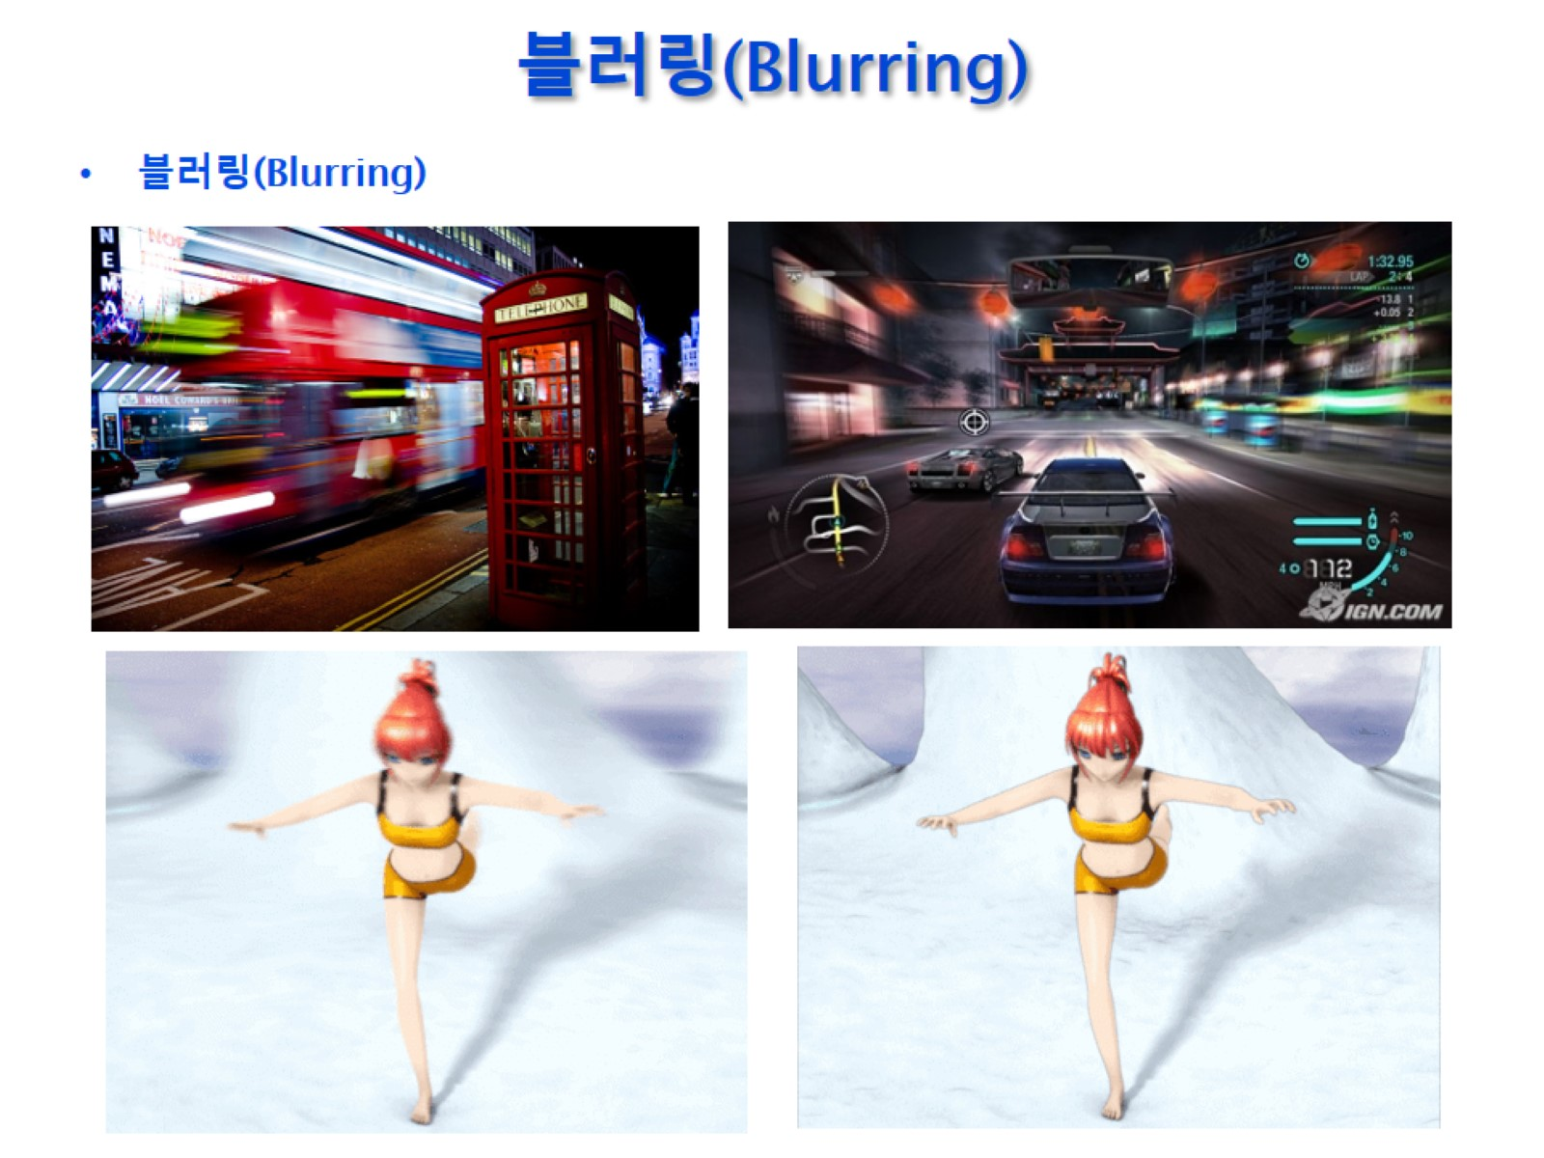
블러링(Blurring)

Slide 4
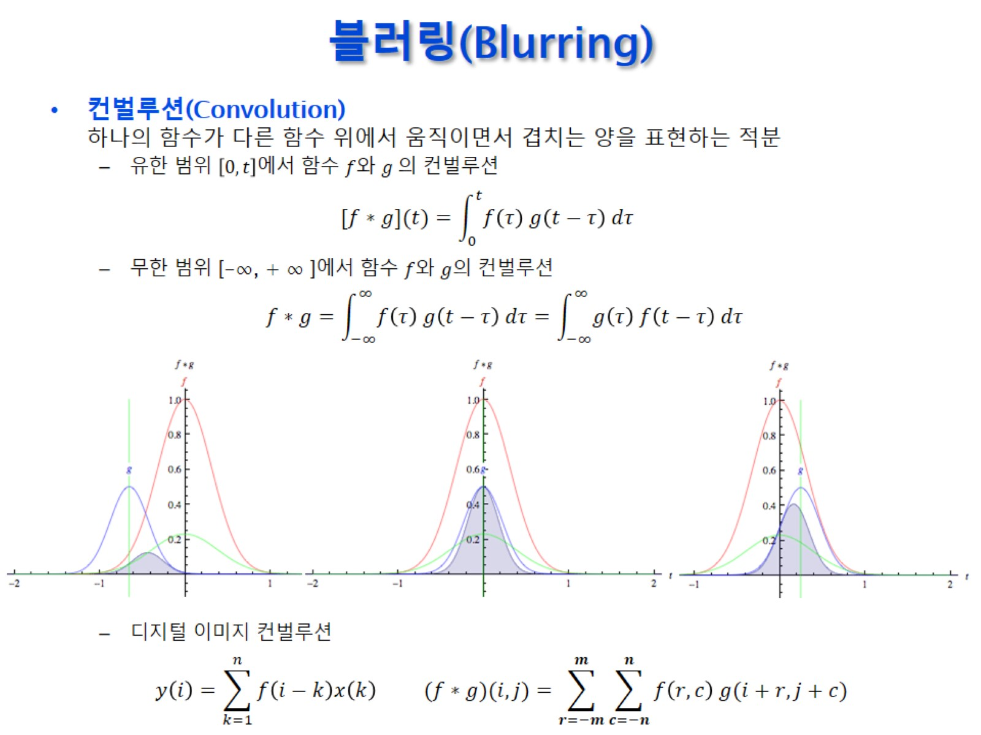
블러링(Blurring)

Slide 5
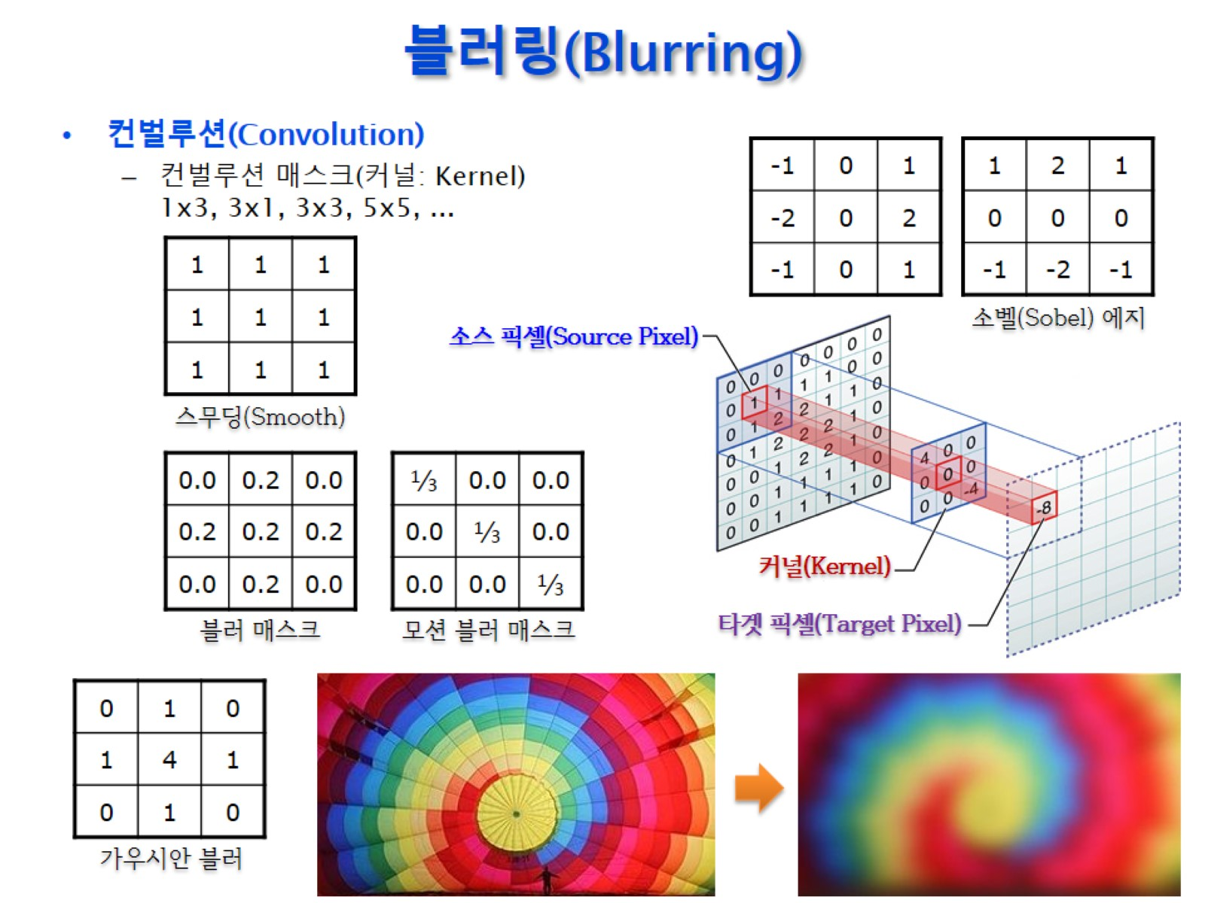
블러링(Blurring)

Slide 6
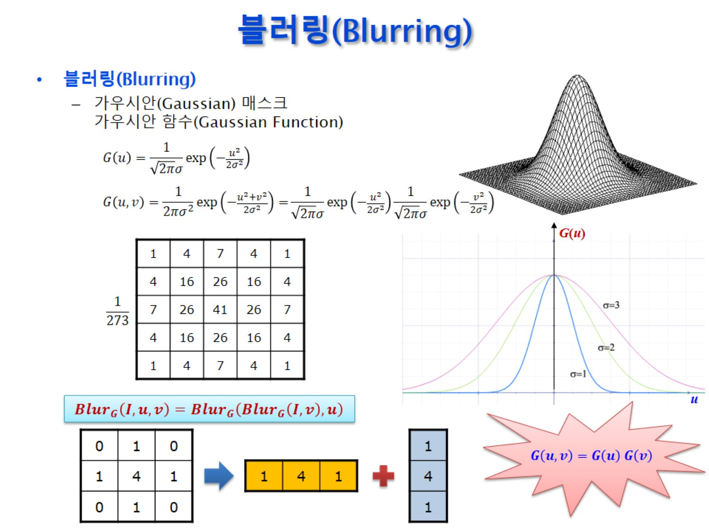
블러링(Blurring)

Slide 7
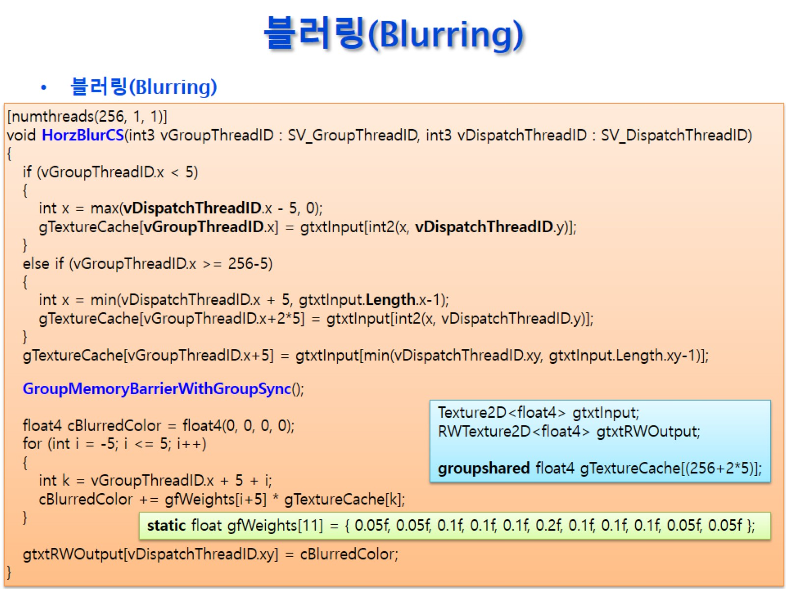
블러링(Blurring)

Slide 8
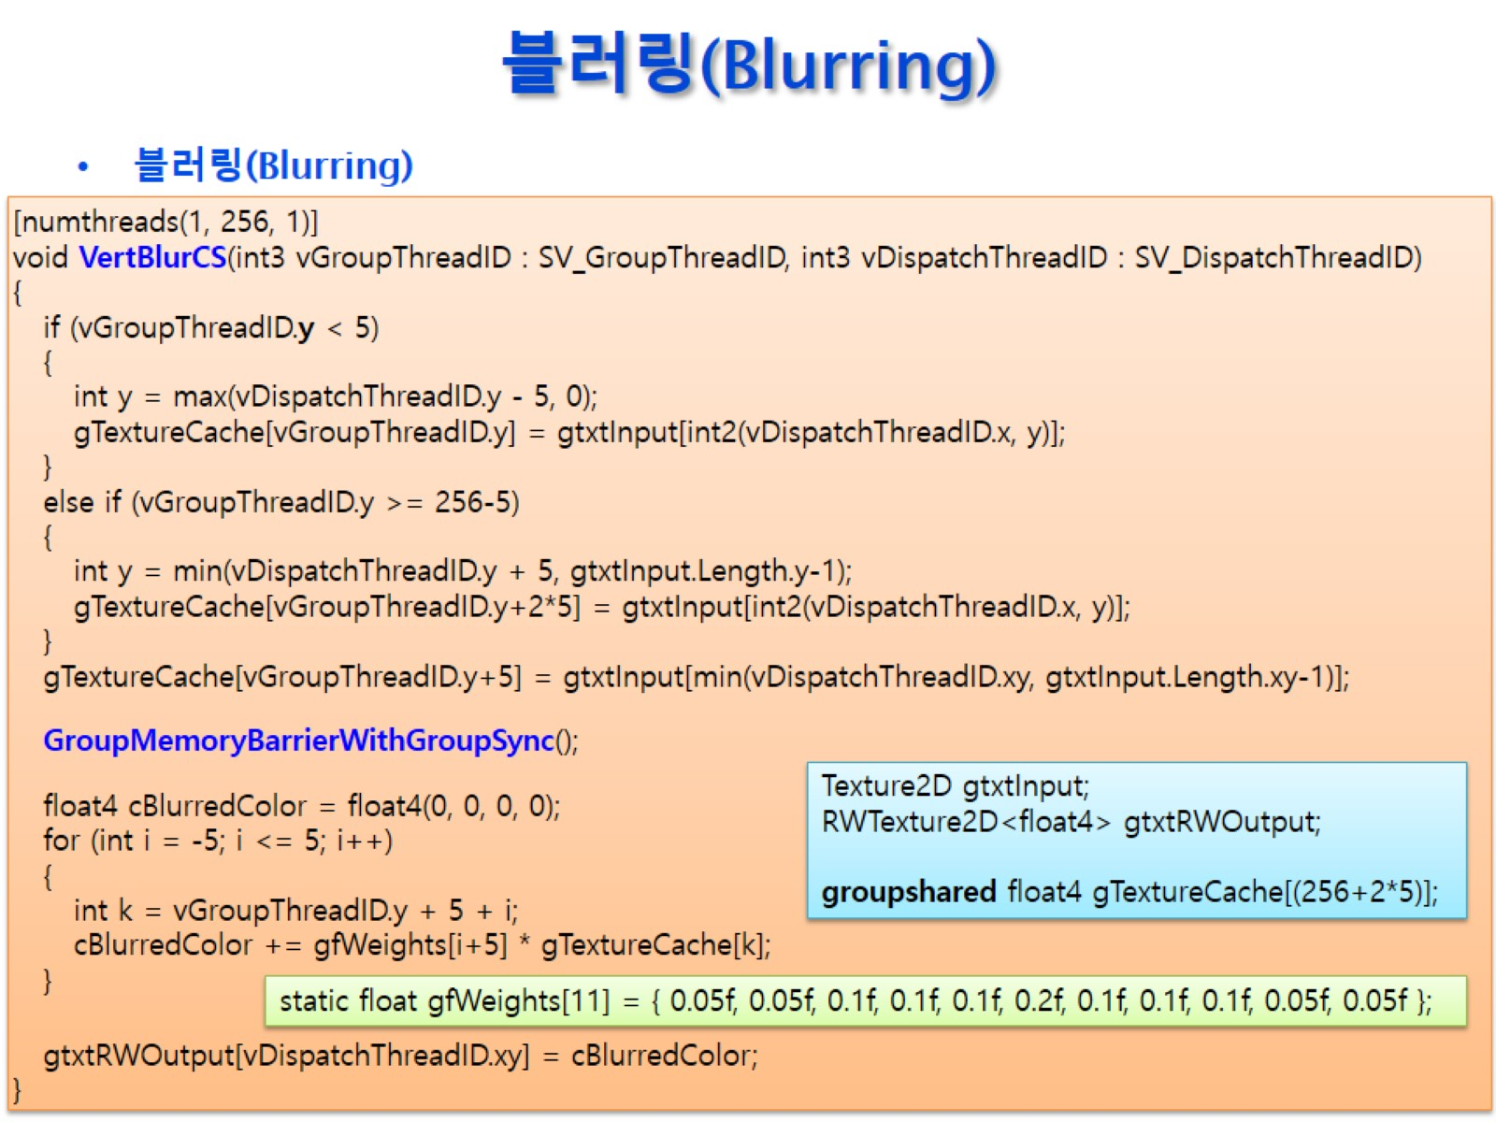
블러링(Blurring)

Slide 9
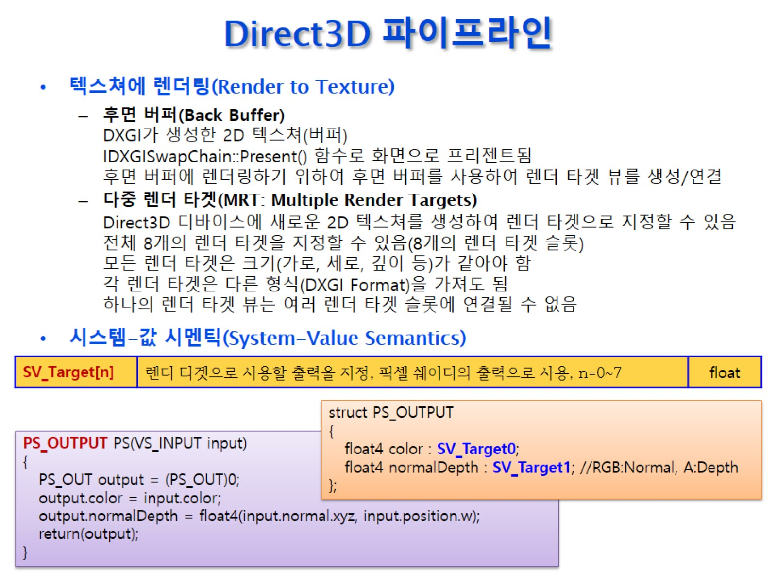
Direct3D 파이프라인

Slide 10
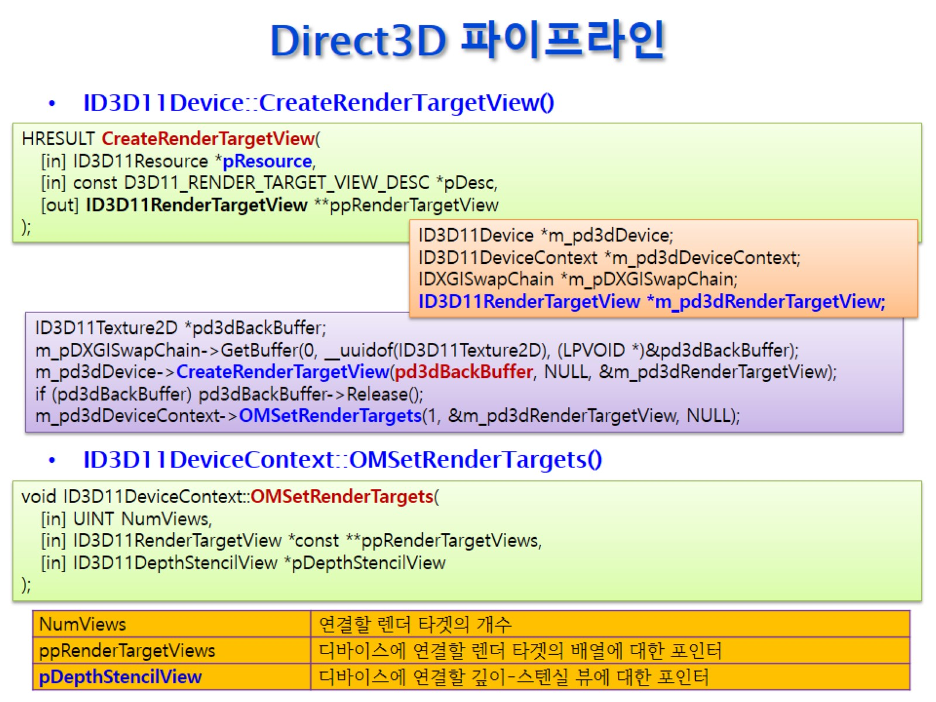
Direct3D 파이프라인

Slide 11
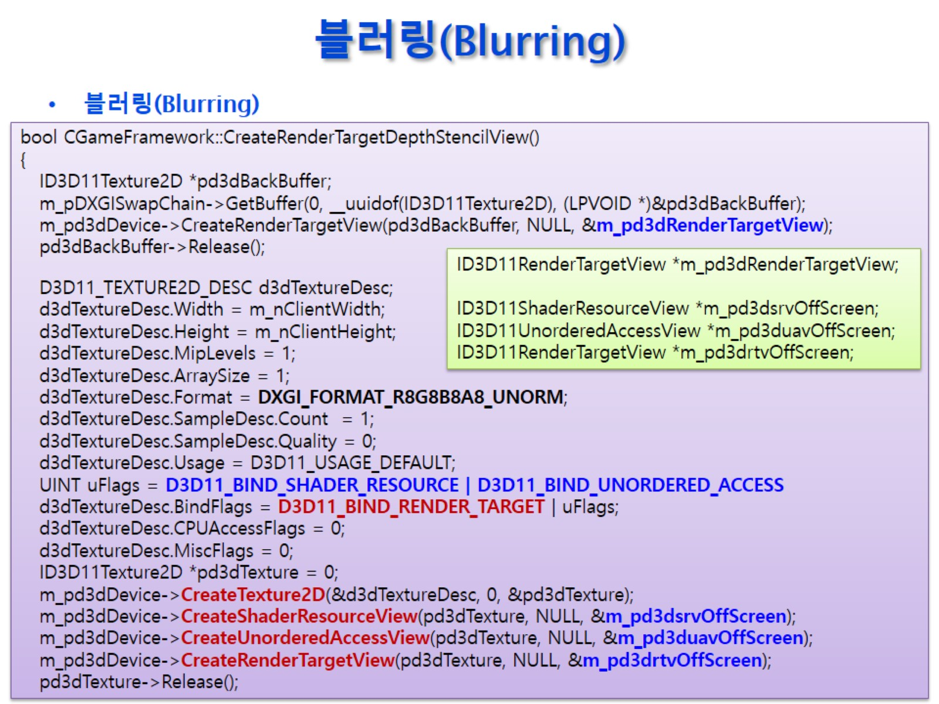
블러링(Blurring)

Slide 12
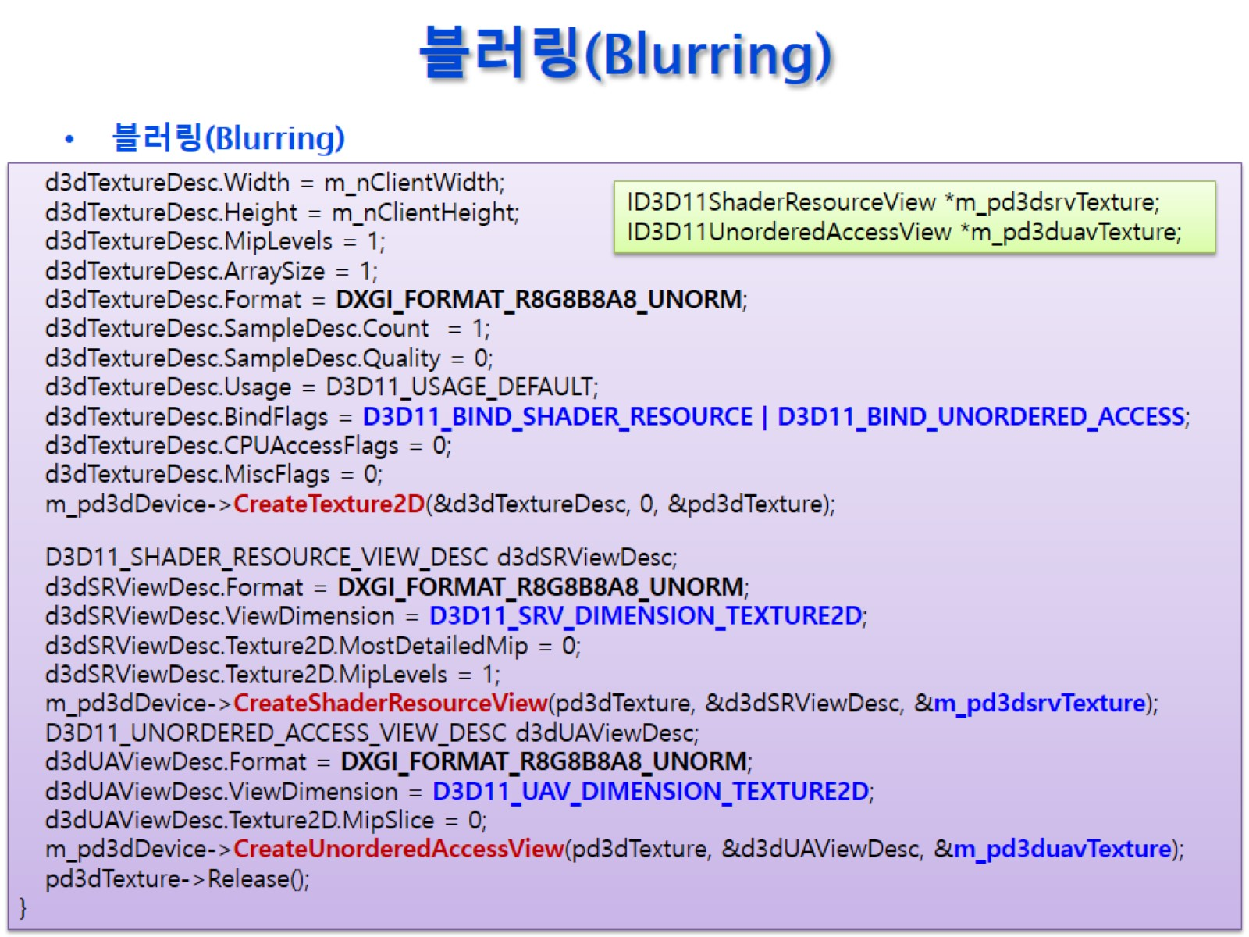
블러링(Blurring)

Slide 13
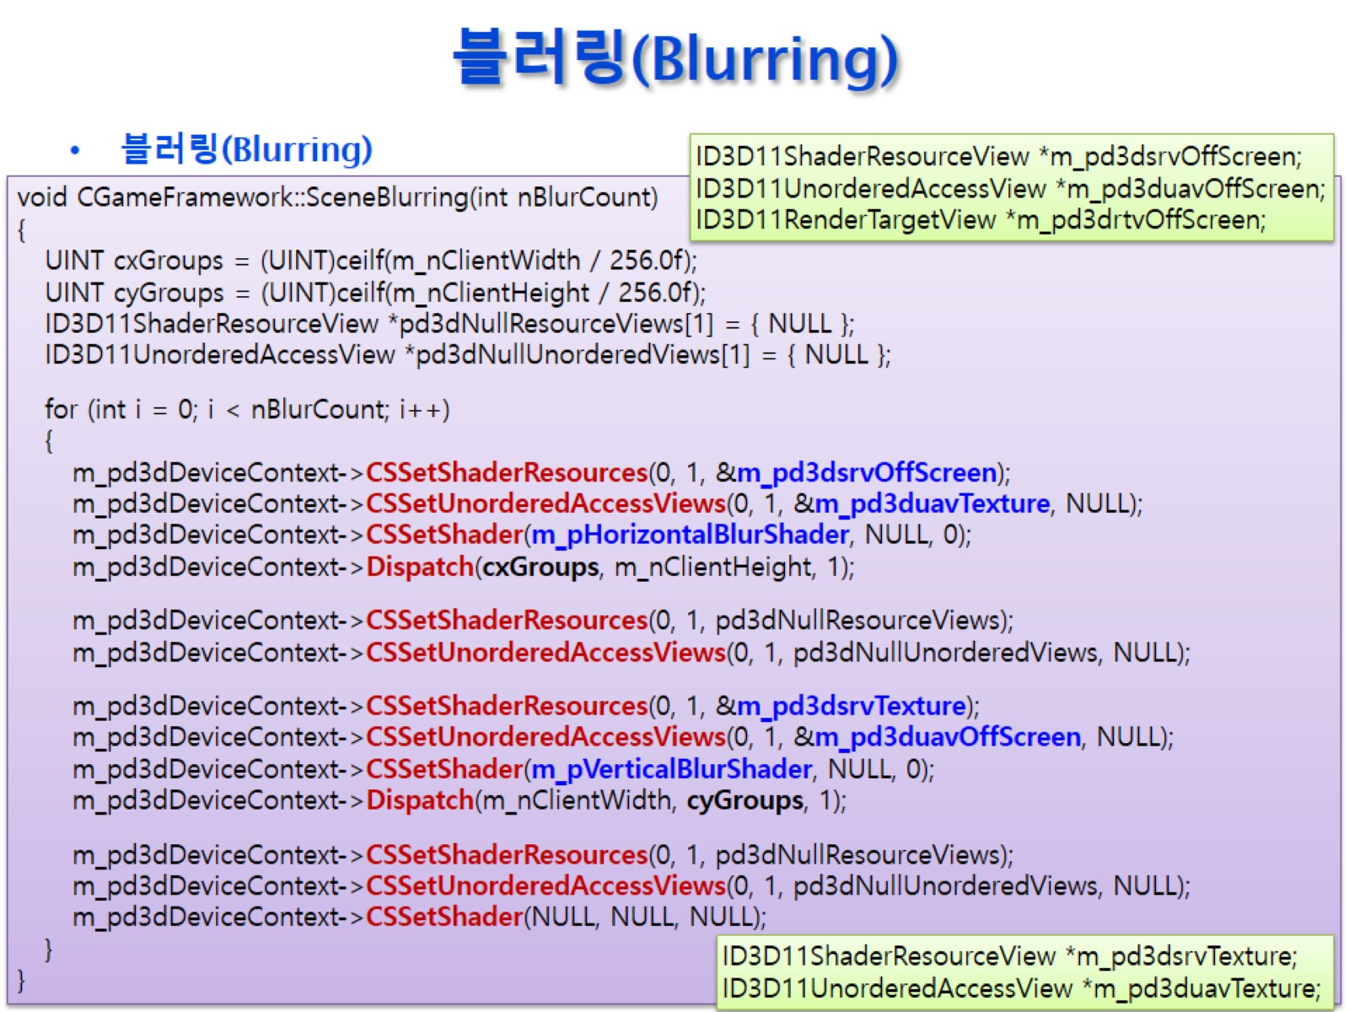
블러링(Blurring)

Slide 14
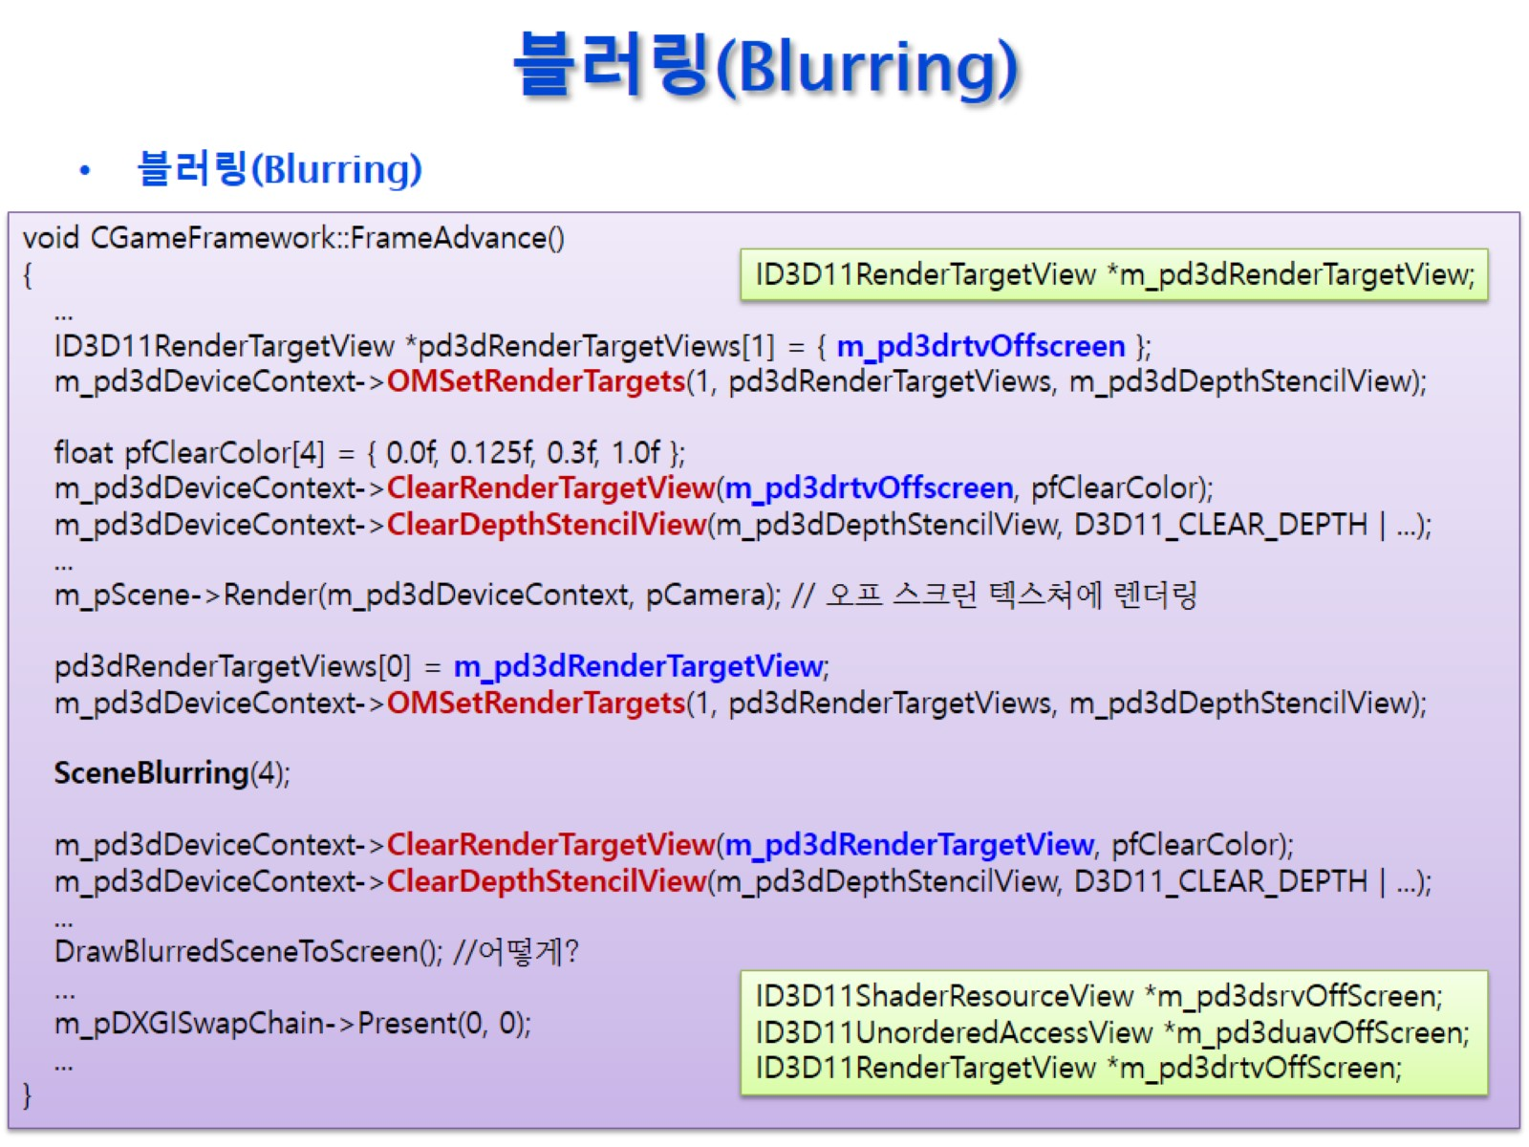
블러링(Blurring)

Slide 15
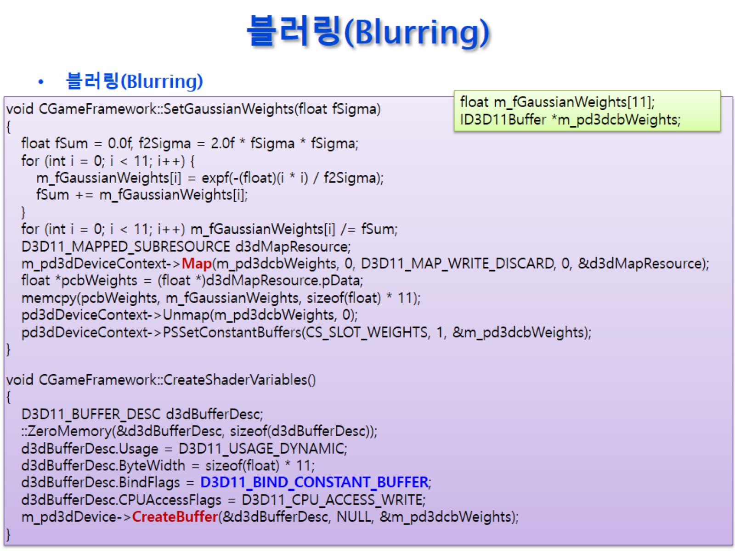
블러링(Blurring)

Slide 16
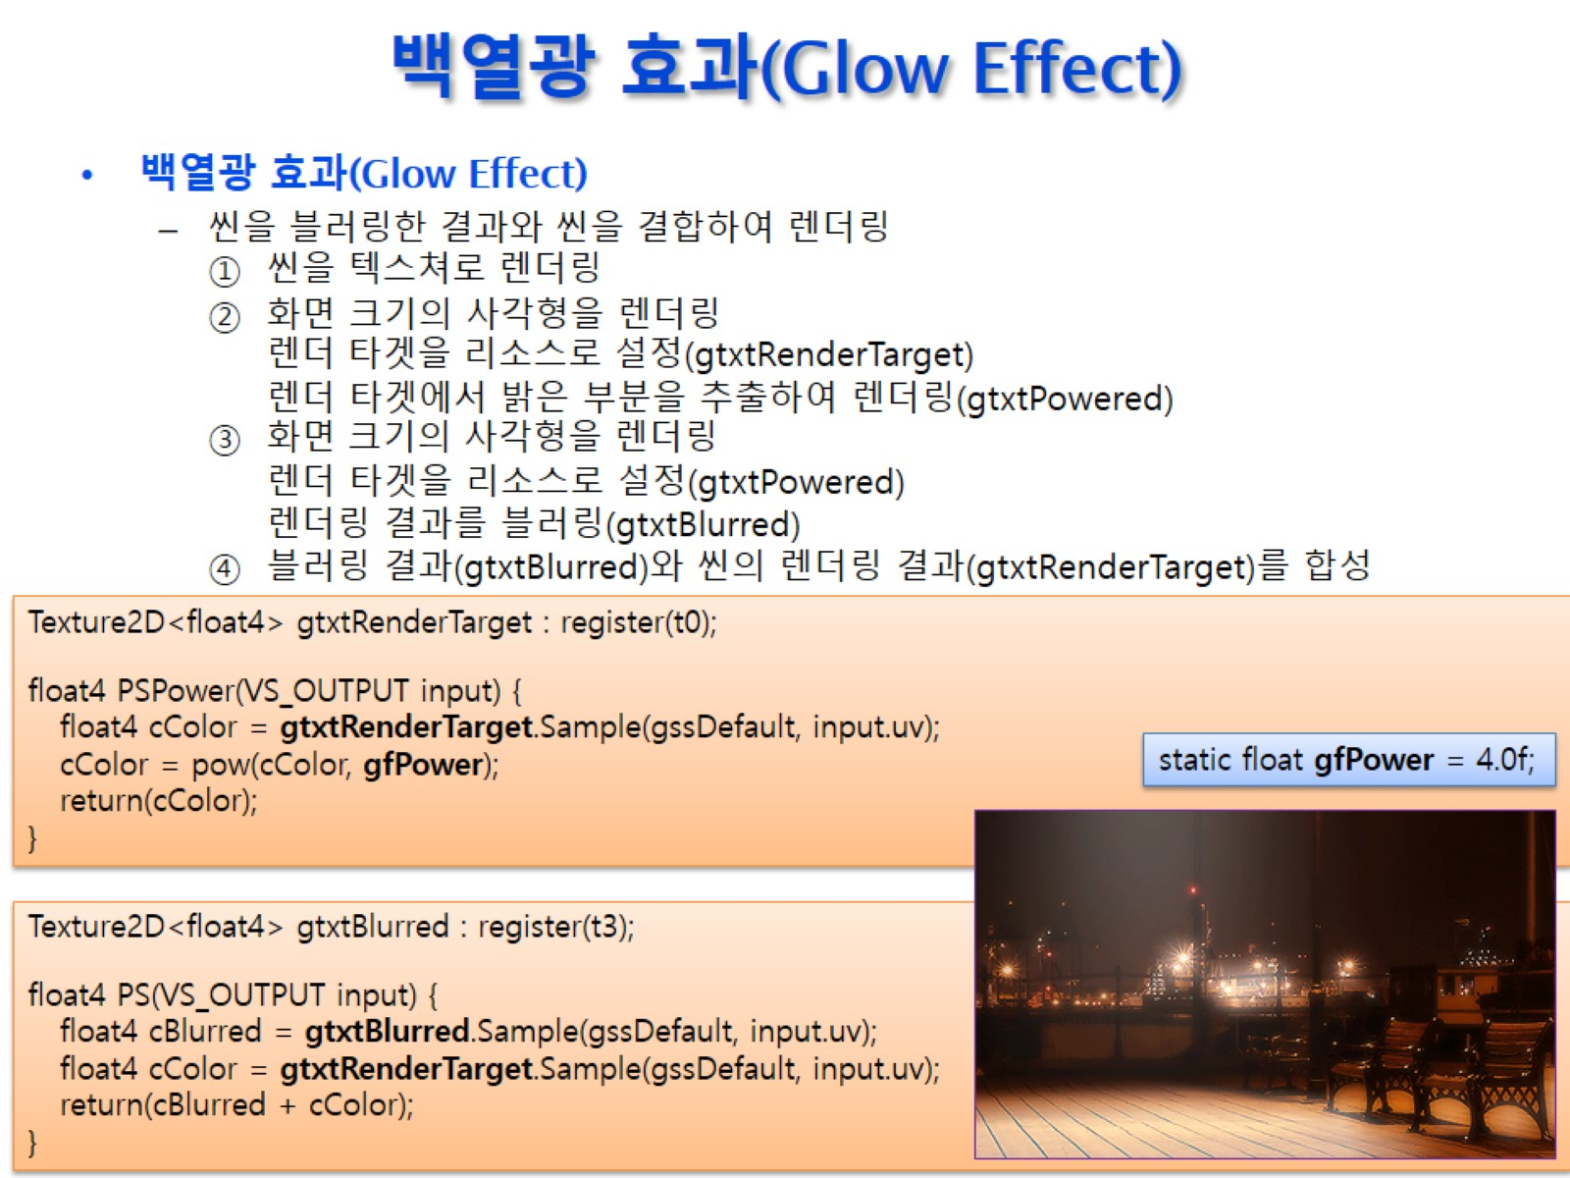
백열광 효과(Glow Effect)

Slide 17
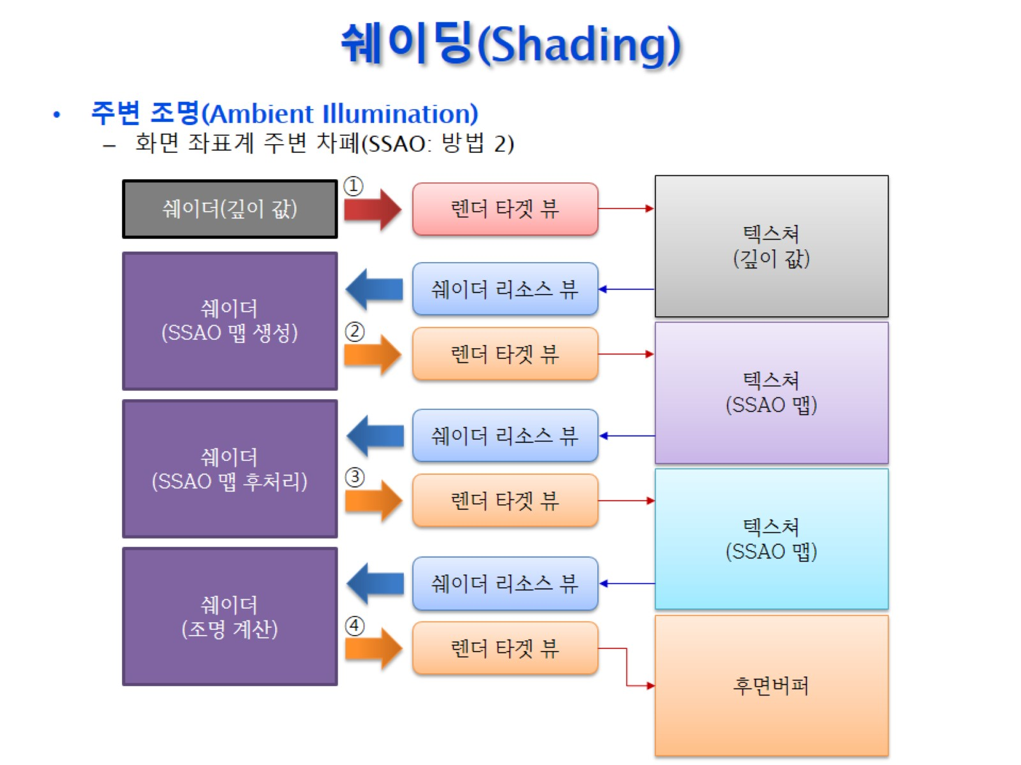
쉐이딩(Shading)

